Slide 1

Notes:
Cover Slide

Slide 2

Notes:
Intro/Hook/Background

Slide 3
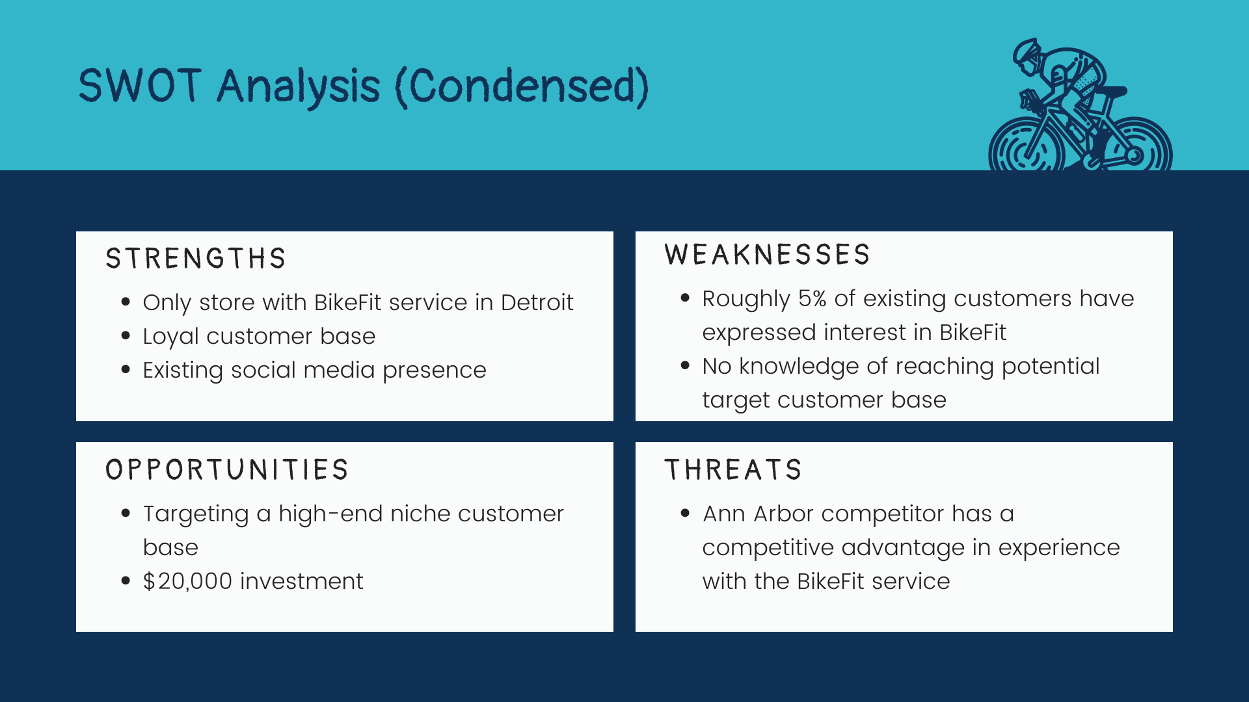
Notes:
SWOT

Slide 4
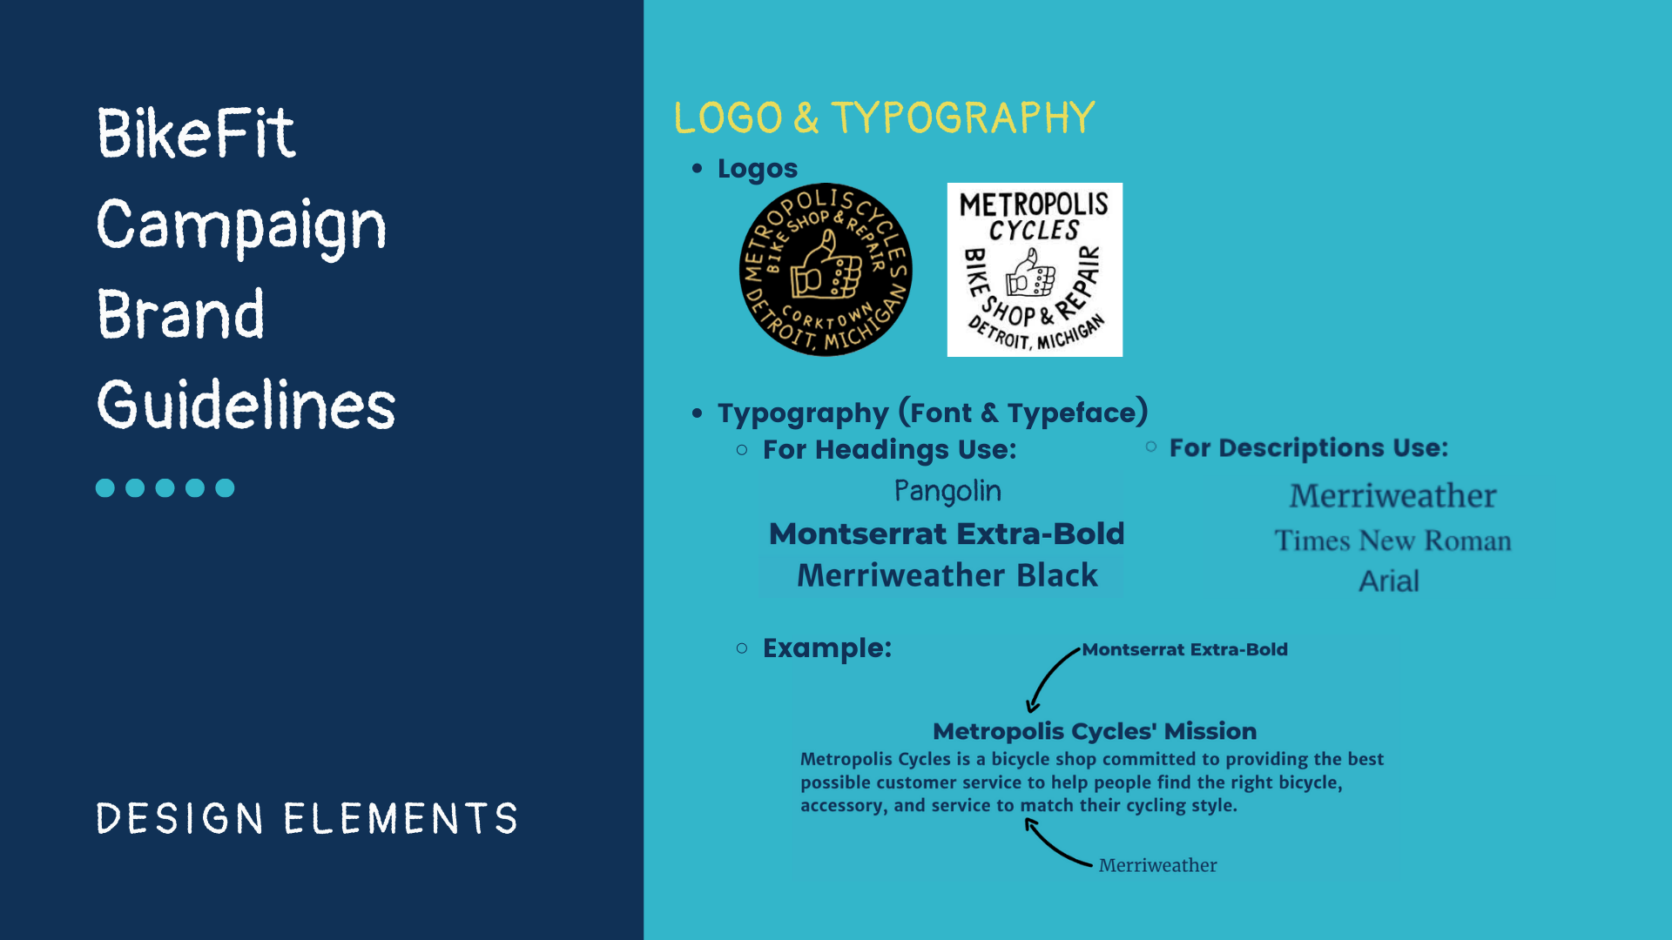
Notes:
Brand Guidelines

Slide 5
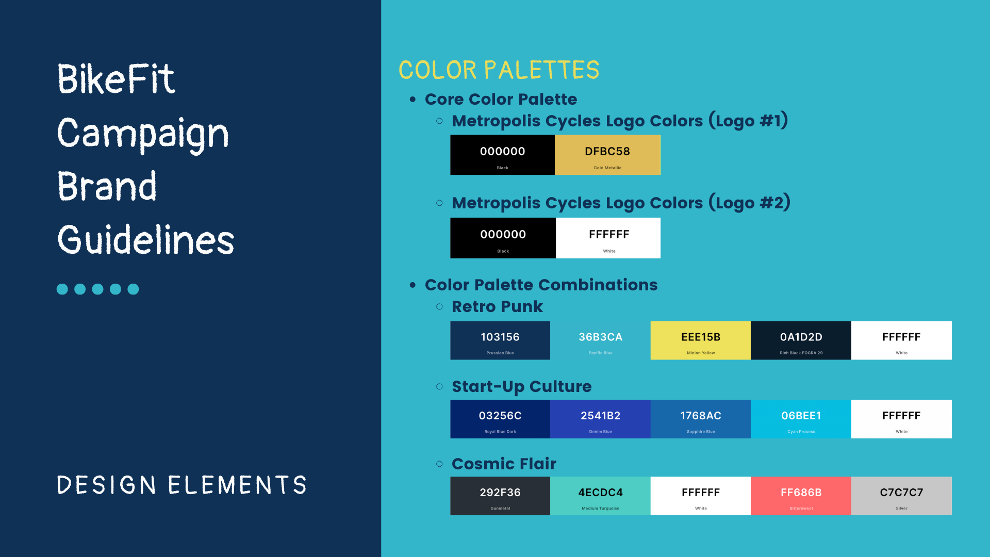
Notes:
Brand Guidelines

Slide 6
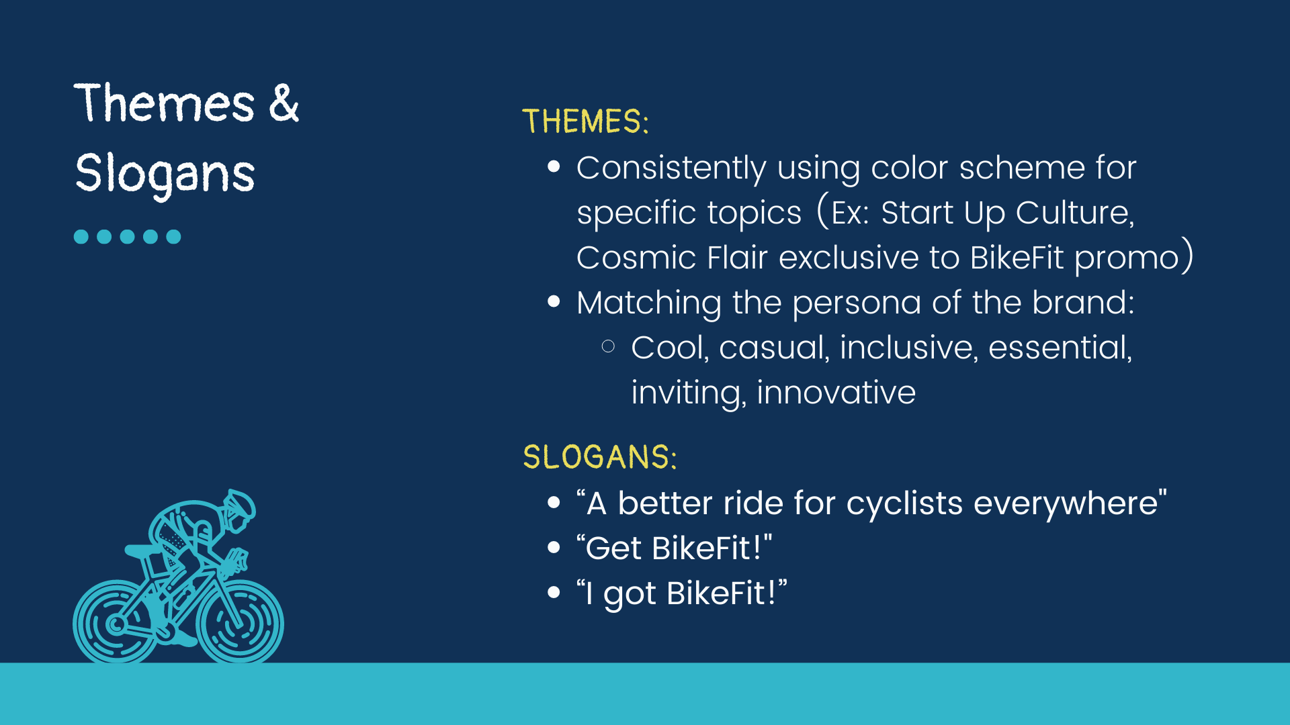
Notes:
Messages and Themes

Slide 7
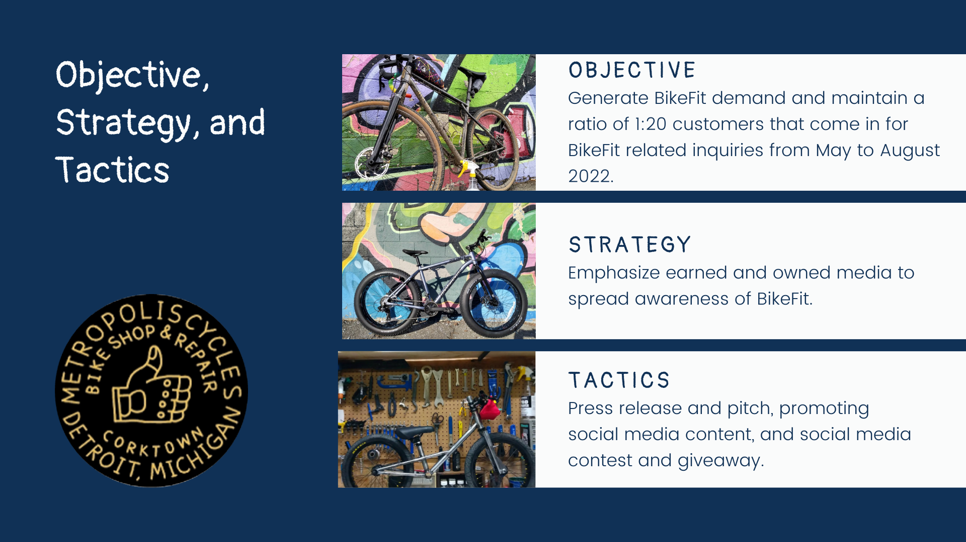
Notes:
Objectives, Strategies, and Tactics

Slide 8
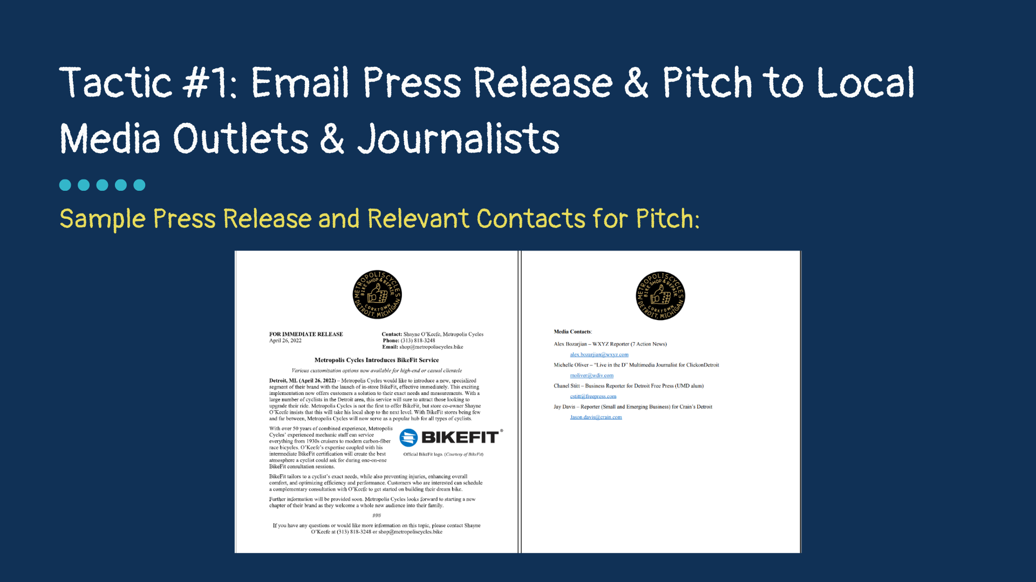
Notes:
Tactics Expanded (TACTIC #1)

Slide 9

Notes:
Tactics Expanded (TACTIC #2)

Slide 10
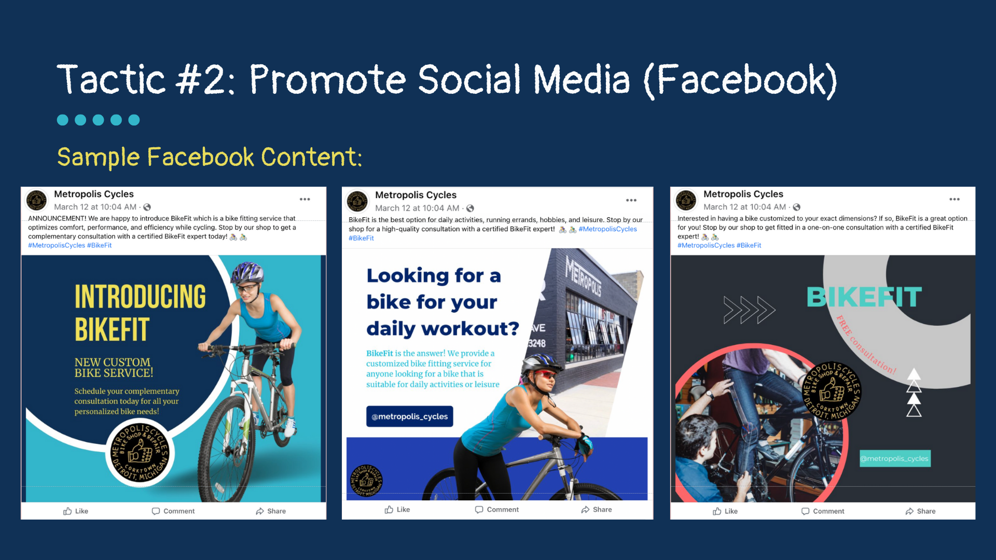
Notes:
Tactics Expanded (TACTIC #2)

Slide 11
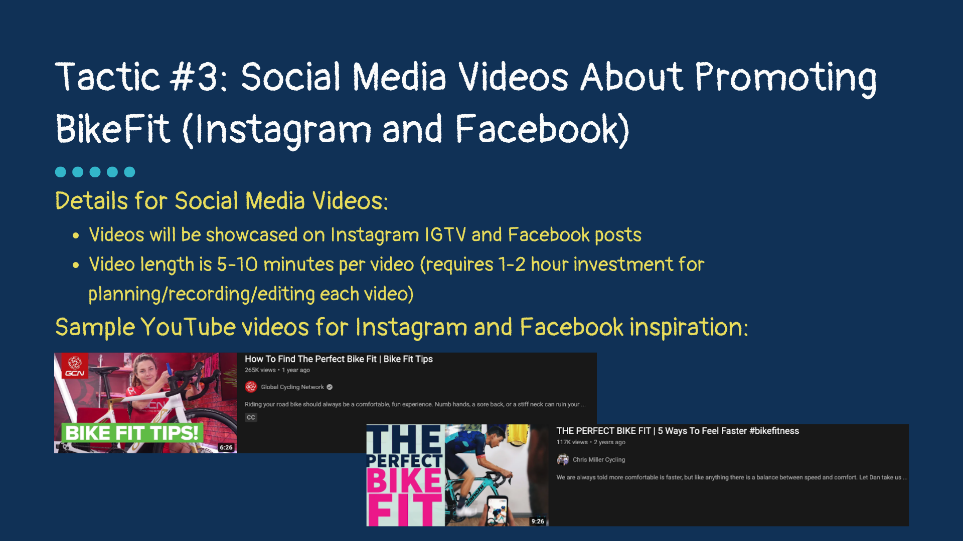
Notes:
Tactics Expanded (TACTIC #3)

Slide 12
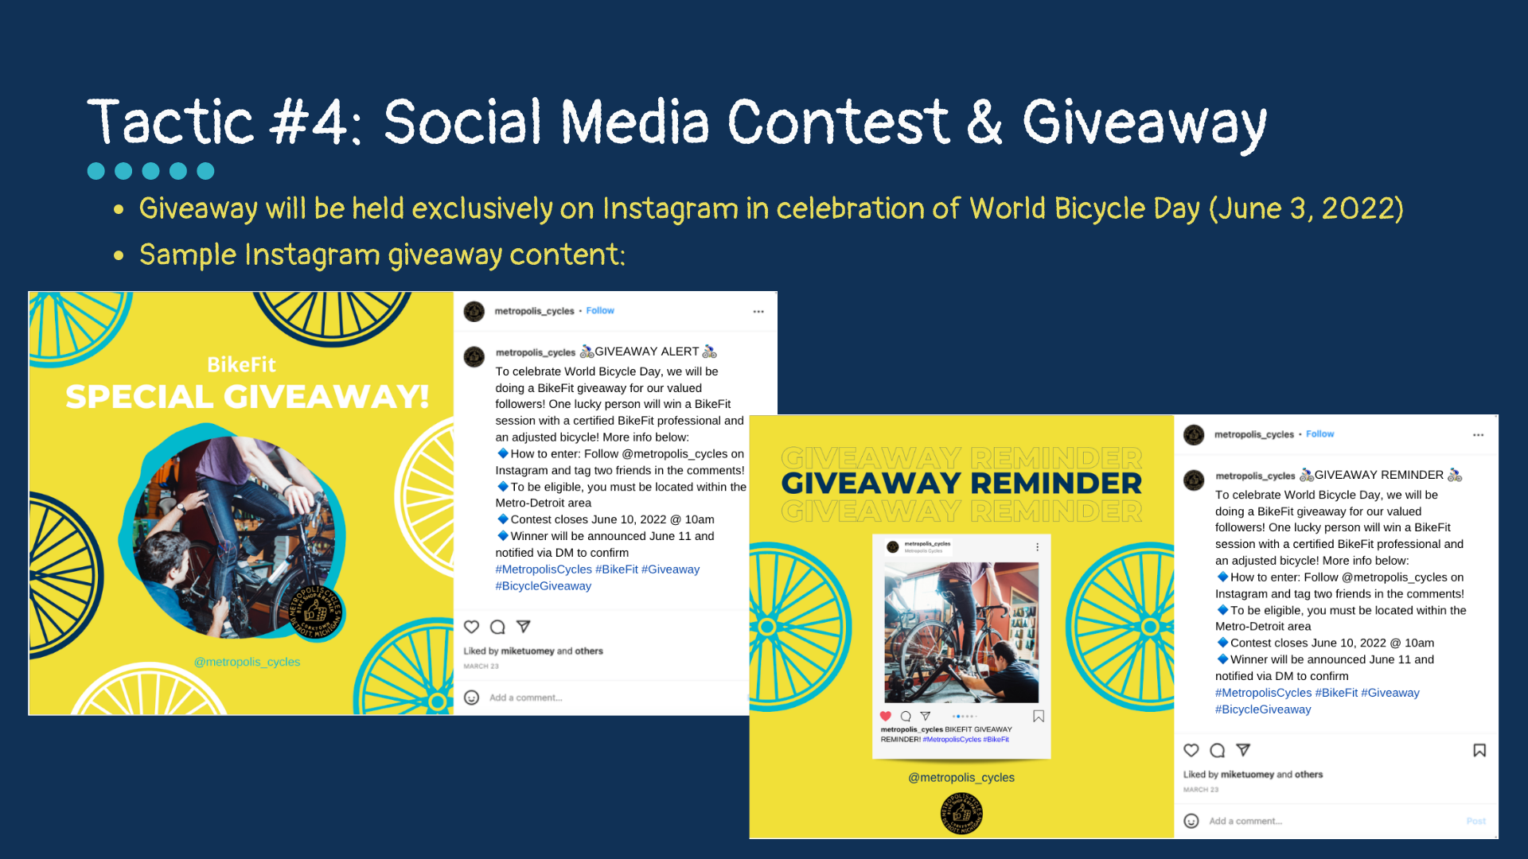
Notes:
Tactics Expanded (TACTIC #4)

Slide 13
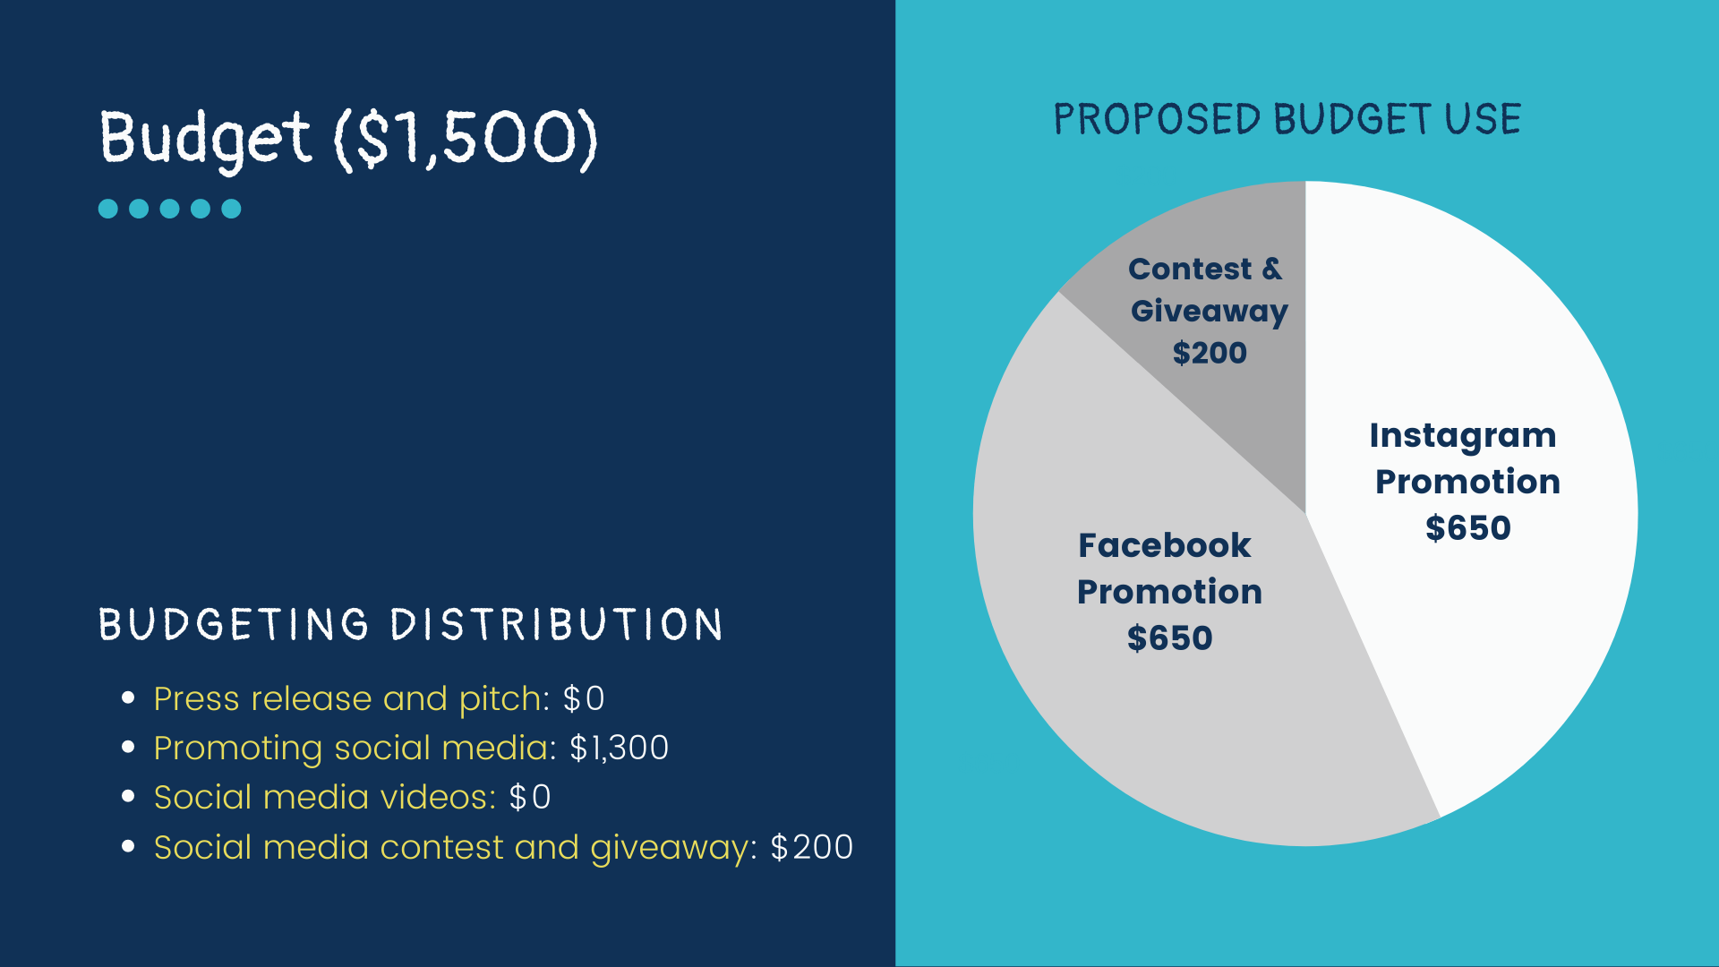
Notes:
Budget

Slide 14
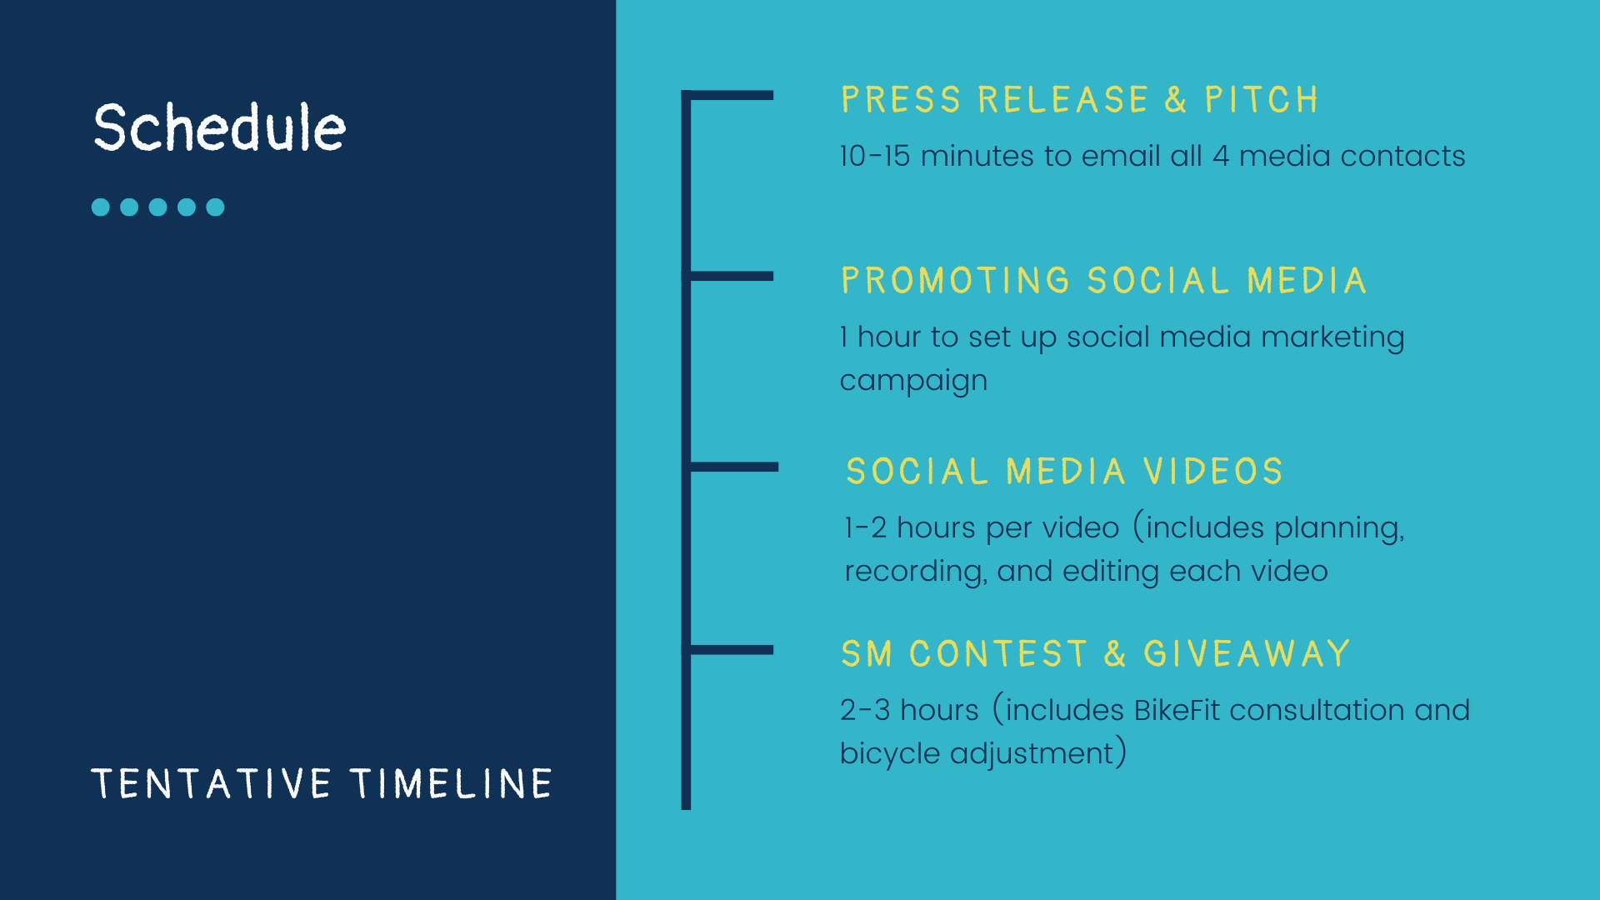
Notes:
Schedule

Slide 15
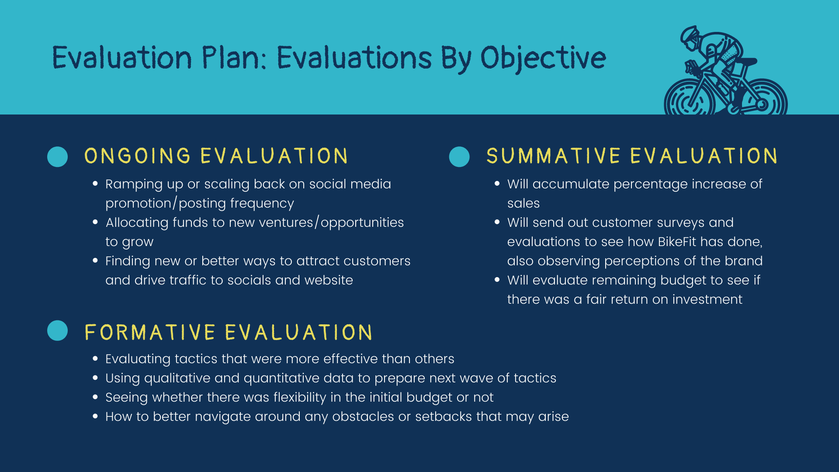
Notes:
Evaluation Plan

Slide 16
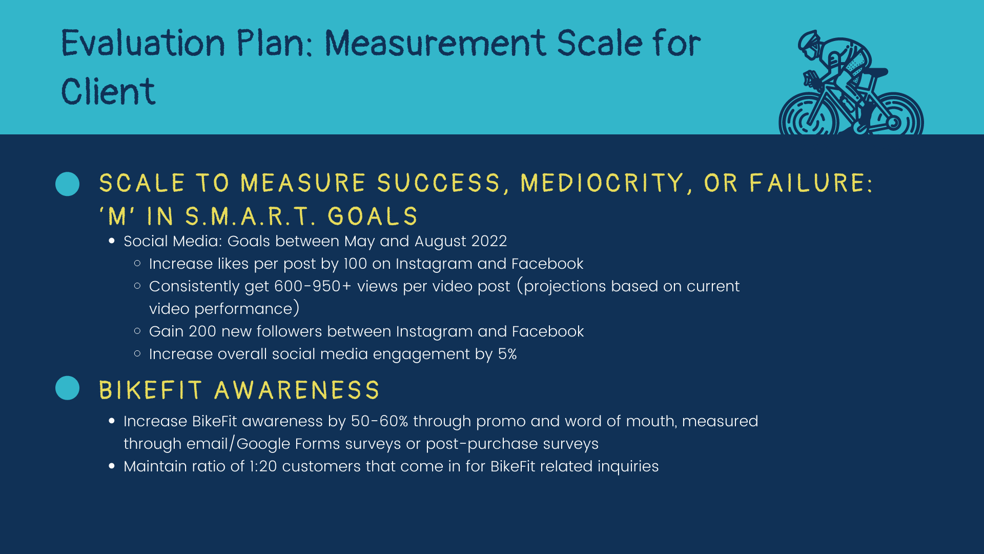
Notes:
Evaluation Plan

Slide 17
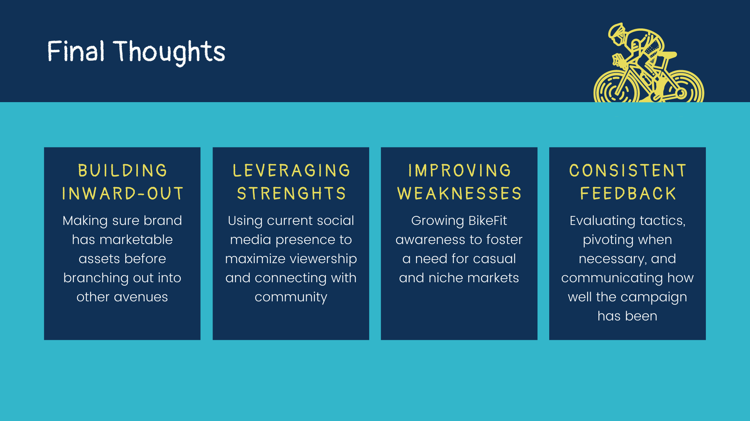
Notes:
Conclusion

Slide 18
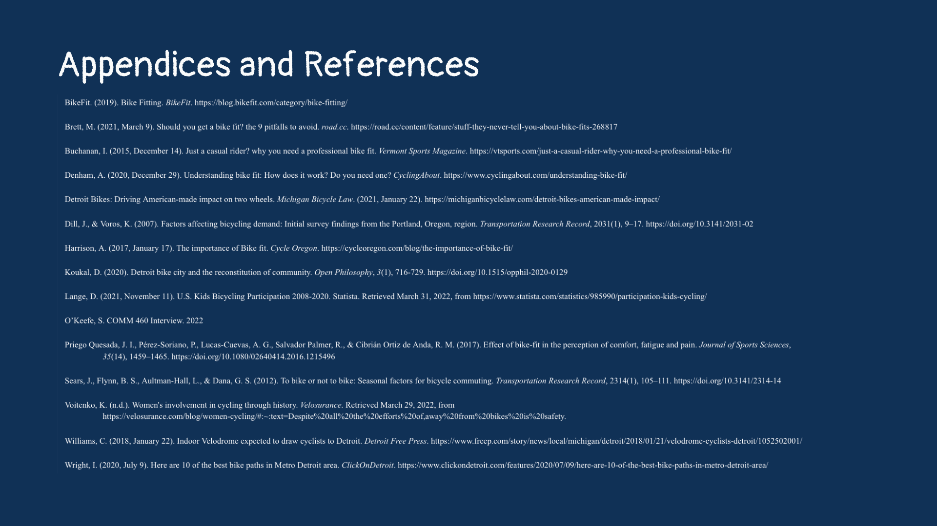
Notes:
Appendices

Slide 19

Notes:
Closure

